Slide 1
Language modelling & text classification
Murad Huseynli

Slide 2

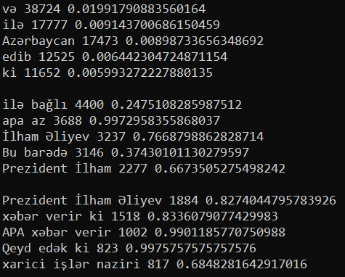

Most frequent n-grams

Slide 3

Perplexity

Slide 4
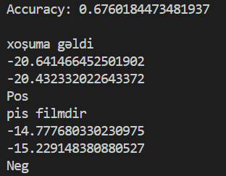
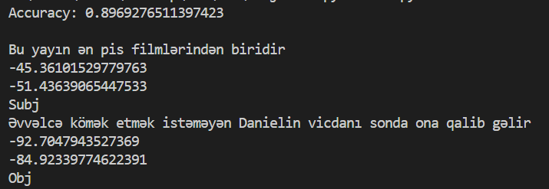
Positive/negative
Naïve Bayes
Objective/subjective

Slide 5
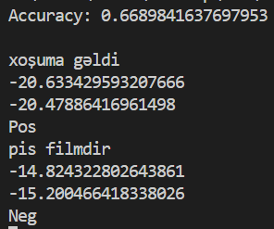
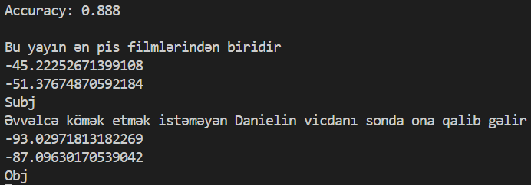
Positive/negative
Naïve Bayes Binary
Objective/subjective

